Slide 1
Pattern: the arrangement of motifs to create a unified design.
-Simplest way of designing a surface treatment
-too much pattern can make a room too busy and uncomfortable
-a room without pattern may be too stark or lacking in character

Slide 2
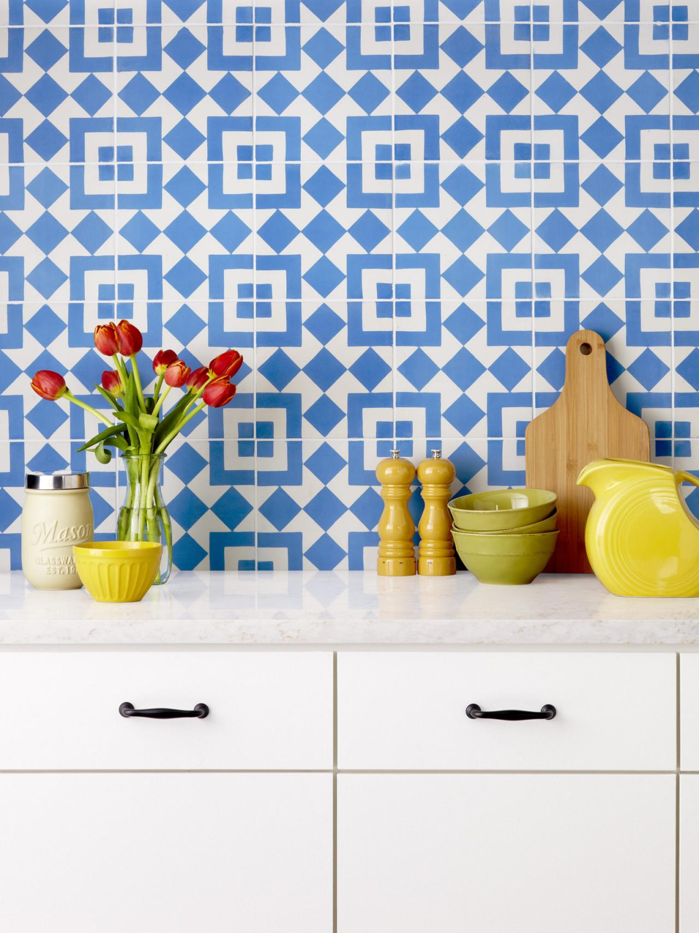
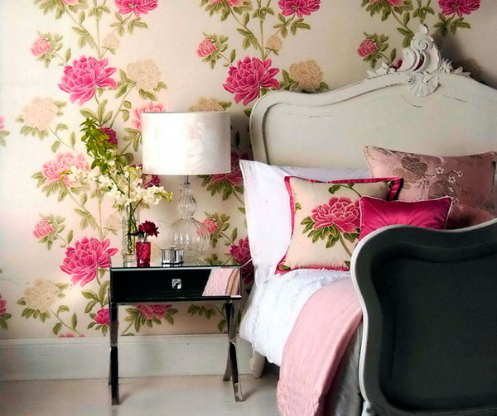

Slide 3
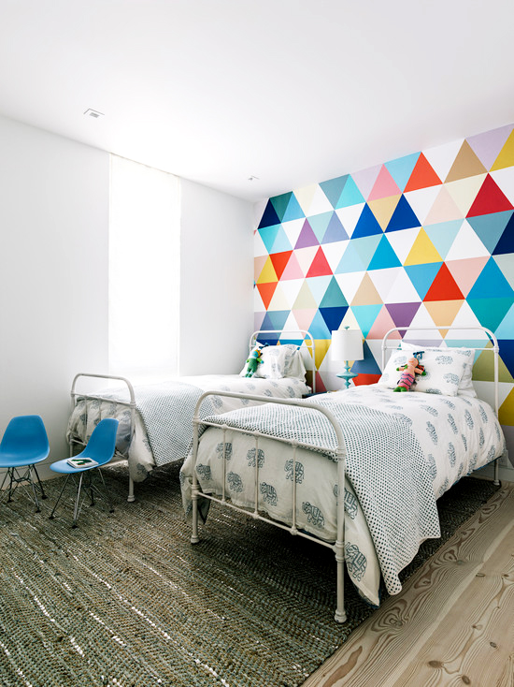
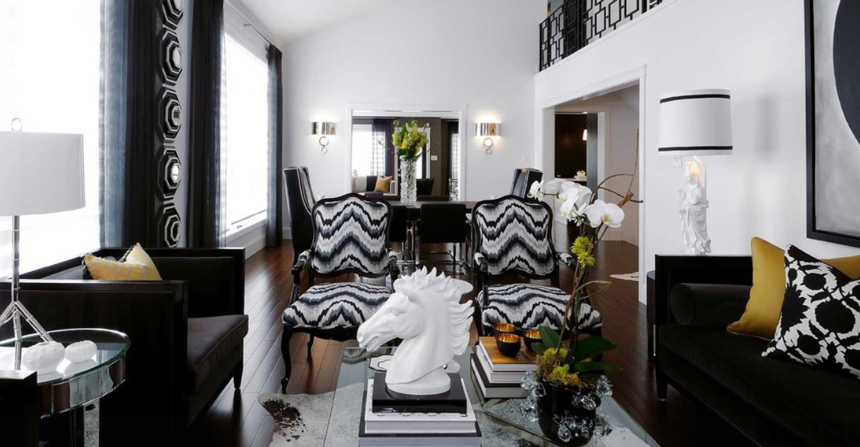

Slide 4
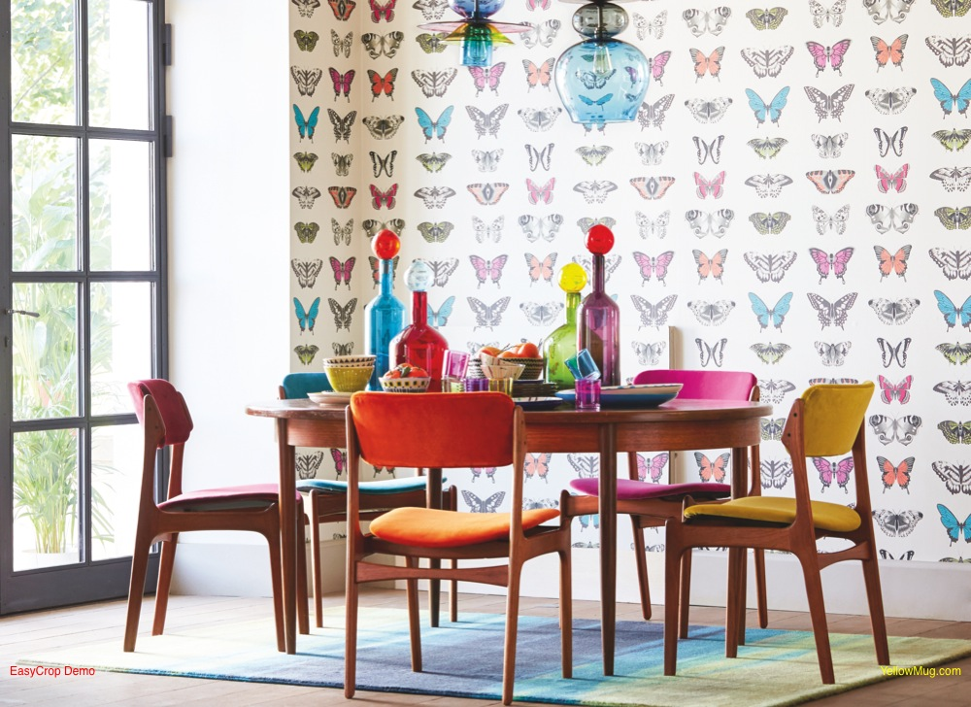
1- Naturalistic: Come from nature, look real and include all details

Slide 5
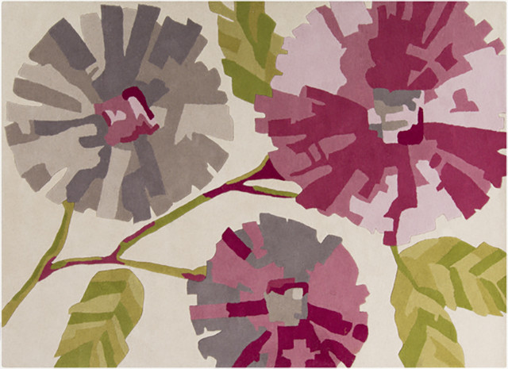
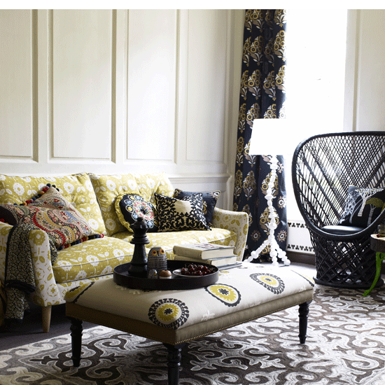
2- Conventional: Man’s interpretation of objects natural or manmade

Slide 6
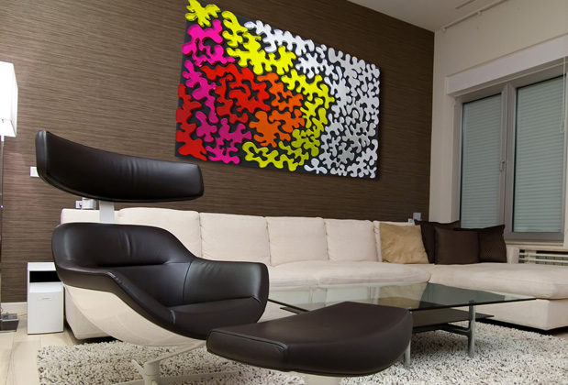
3- Abstract: No set, followed or repeated pattern

Slide 7
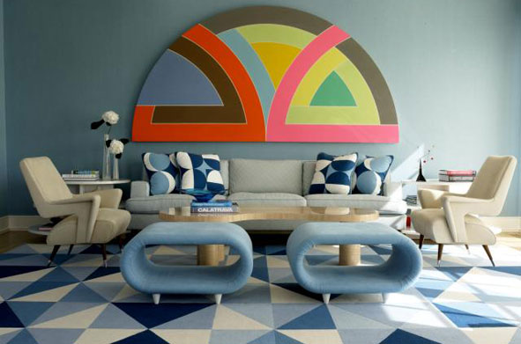
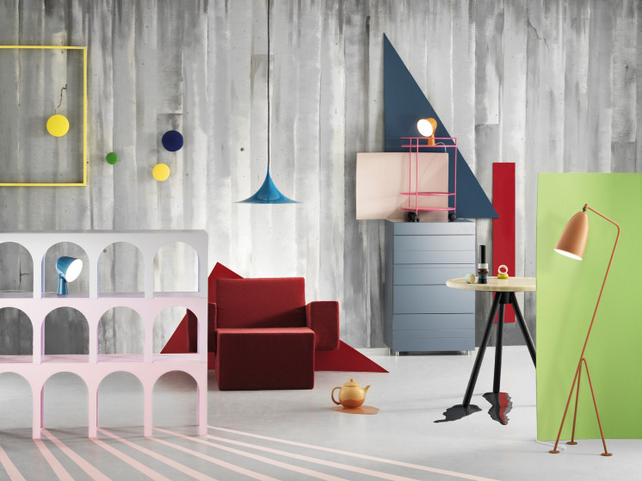
4- Geometric: Use of shapes– lines, stripes, plaids, etc.

Slide 8
To achieve a feeling of correctness in combing pattern:
1- Evaluate the placement of patterns
2- Know the character of the pattern
3- Identify color scheme of pattern
4- Use a variety of size or patterns

Slide 9
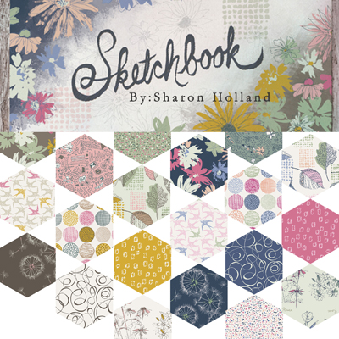
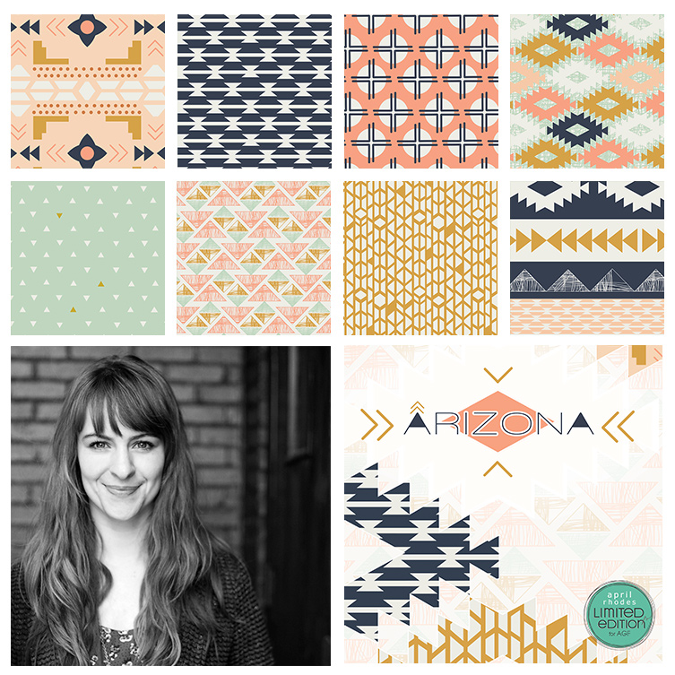
Examples of fabric collections

Slide 11
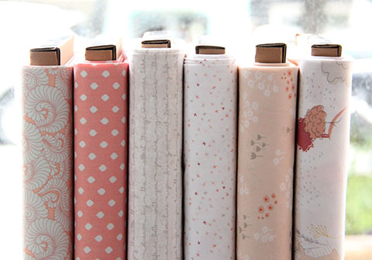

Slide 12
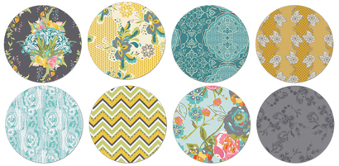

Slide 14
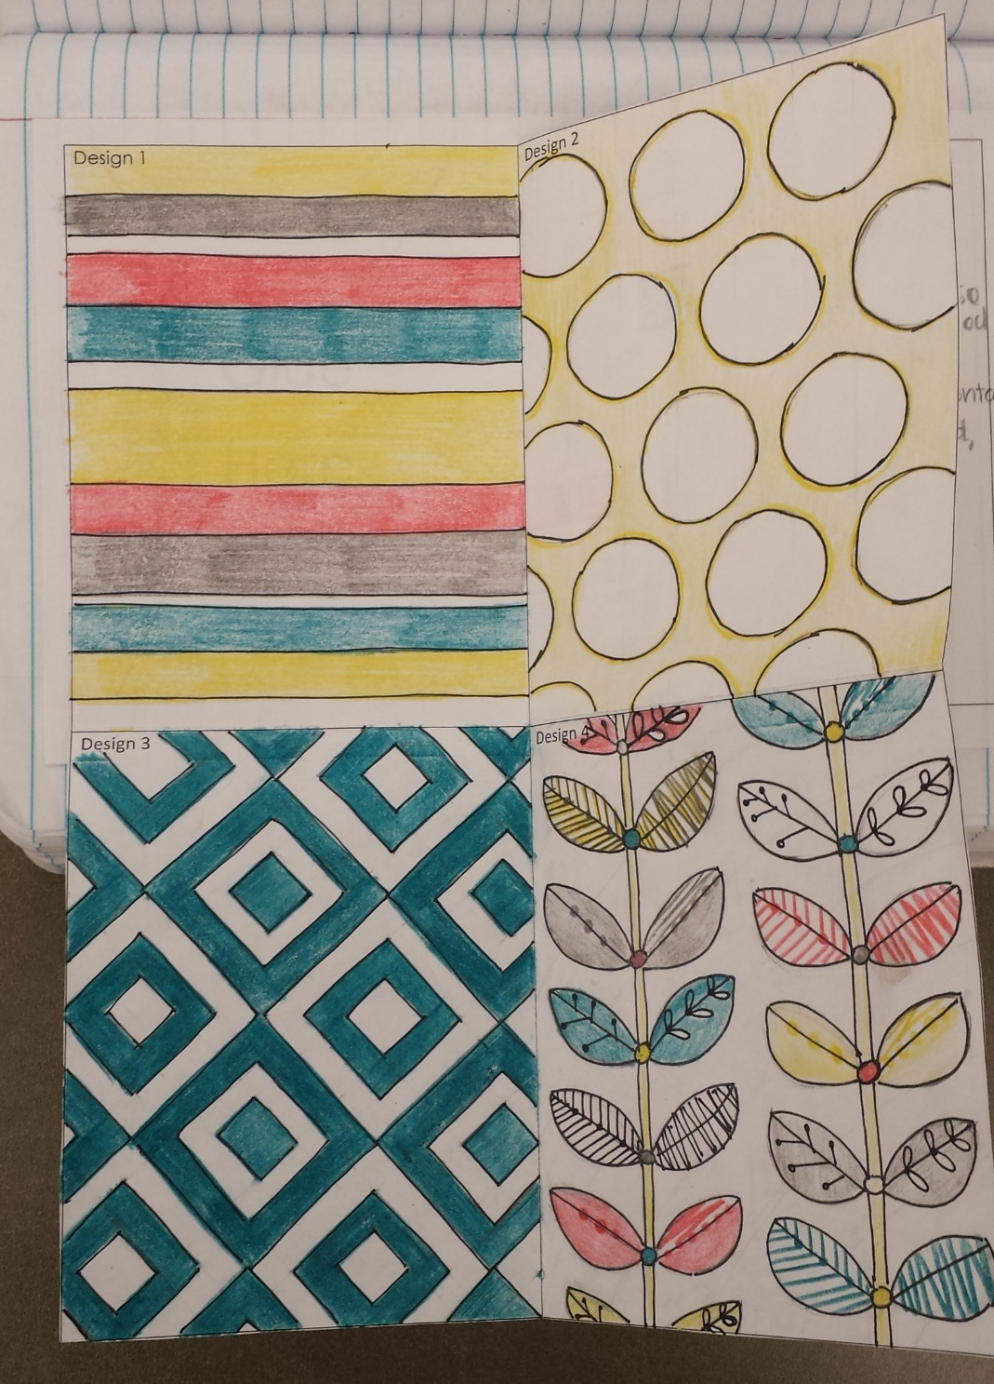
Assignment
Create 4 different patterns that together create a fabric collection. The designs from your collection could be made into fabric for pillows, bedding, curtains, etc.
You may choose to include a minimum of 2 of the four different types of pattern, but feel free to include all four
Naturalistic
Conventional
Abstract
Geometric
Your four patterns should go together using theme and color like the fabric examples from the PowerPoint

